Slide 1
BTech 451
University of Auckland
Priyal Bangia
Pban489
5648682

Slide 2

Orion Health
Founded in 1993
Leading global provider of healthcare integration solutions.
The products and solutions are implemented in more than 30 countries
Clinicians to facilitate care
Notes:
Orion Health is a leading global provider of Healthcare integration solutions.
Just to remind you, Orion health implements and provides various facilities to hospitals such as
electronic health record,
Hospital information system.
collaborative care to securely and easily exchange clinical information with other organizations,
Also another product called Orion health mobile for iphones or apple devices provides complete flexibility for healthcare professionals.
Products and implementations which were built by this company are used by 30+ countries.
Where hundreds of thousands of clinicians are taking advantage of these facilities to help facilitate care for tens of millions of patients.

Slide 3
What is Business Intelligence (BI)?
Transformation of raw data into meaningful information.
Allows easy interpretation of volumes of data.
Helps create Strategic business opportunities.
Common BI technologies are:
Reporting
Analytics
Data Mining
Notes:
transformation of raw data into meaningful and useful information for business analysis purposes.
Easier for analysis – structured – clear view
BI can handle enormous amounts of unstructured data to help identity, develop and create new strategic opportunities.
Using these can provide historical, current and predictive business operation views→Better decision making.

Slide 4
Introduction/Problem
Data stored is in an unreadable, unstructured form
Difficult to analyse and provide meaningful data to management
Reports are being manually generated
Includes the process of querying/filtering/manipulating recursively.
Not up-to-date
The whole process is very time consuming and tedious
Unnecessary effort
Notes:
Talk about the current system then problem again.
Now Orion Health who provide products locally and globally…. But the
data stored in unreadable, unstructured form
Very difficult to analyse.. Hard to make sense of data and no meaning to it when you look at raw data.. Not going to get much out of it. Might lead to worse decisions rather then better.
Difficult to provide meaningful data to management so they can make better decisions.
reports being manually created – will run you through an example soon
Difficult for Complaint Administrators and Data Analytics to carry out the process to provide meaningful data to management in a fast paced environment.
Takes too much time and extra effort – even with the technology that we have today – you’ll see what I mean when I explain the process to you.

Slide 5
Current System
Essential process:
Issue ticket→Support application
Pre and post questionnaire determines if the alleged problem is legitimate or not (for example – a bug).
If the result is yes for either questionnaires, this is considered as a complaint.
Complaints are read through and manually ‘coded’
There is already a lot being done already..
Notes:
Will take you through the whole process from when a ticket is issued to reporting.
The process begins with issues coming in on a support application which Orion Health uses (Support tracker).
Before an investigation, Regional analysts will complete a Pre-investigation on the issue that has come by reading what the customer has written.
The result of that questionnaire then determines whether the report is alleged to be a problem represented by 1 or 0 emphasising yes or no which is recorded in the database table.

Slide 6
Current System (2)
Finally, support application is used to query by search function.
Data is Filtered & Manipulated
Then exported into csv file
Then to Excel
This is used to create a variety of graphs, tables and analytics using excel or Tableau.
Notes:
Administrator uses the support application to query the expected output
the data then needs to be filtered and manipulated
then exported into an csv file
then into an excel file
consultant has to manually create graphs, tables and analytics using excel and tableau.
The graphs are then copy and pasted onto a word document which is taken to meetings or passed onto department managers.
REPEAT PROCESS - WHAT HAPPENS THE NEXT MONTH OR WHEN YOU NEED A DIFFERENT REPORT AND ALSO WHEN THERE IS NEW INFO?? As the data is updated on the support system, the whole process needs to be under taken again therefore the query needs to be written out again which then is manipulated and exported into a cvs file then excel or where the graphs are updated or tabelo where the graphs are created again. This cycle is continuous and is required to be done continuously so the management get up-to-date information whether is it yearly, monthly or weekly.

Slide 7
Related Work
Development of a Clinical Data Warehouse for Hospital Infection Control
A system-wide relational database linking laboratory, pharmacy, and administrative data did not exist
Accessing, organizing, and using these data are evolving challenges for hospital systems.
Aim - Hospital information system that could recognize and report trends in antimicrobial use and resistance.
Notes:
Development of a Clinical Data Warehouse for Hospital Infection Control
As is common in health care, a system-wide relational database linking laboratory, pharmacy, and administrative data did not exist.
Accessing, organizing, and using these data to support research and quality improvement projects are evolving challenges for hospital systems.
Because the vendors did not provide easy access so the authors developed a clinical data warehouse for hospital infection control by importing data from the information systems of three affiliated public hospitals.
One of the key goals is development of a hospital information system that could recognize and report trends in antimicrobial use and resistance.
The clinical data warehouse was designed to store data collected from nonelectronic sources (e.g., manually abstracted data from patient medical records and surveys scanned using optical character recognition) and to store imported electronic data from existing hospital information systems.
O ensure open database connectivity (ODBC) linkages to different database platforms (e.g., application databases from Pharmacy and Laboratory) they used DTS (Data transformation Services) functions of SQL.
This function was programmed to automate data extraction from each primary server to our clinical data warehouse.
Although programming simple queries to provide descriptive statistics was performed readily,
Used consulting firms/statition itions to extract info about the care by patients with infectious deseases.

Slide 8
Related Work
The clinical data warehouse was designed to store data collected from nonelectronic sources & electrical
Used DTS
Automated data extraction from primary server to clinic server in a timely manner.
Programming is used to query
Consultant/statition hired for complex queries.
Notes:
Many more companies follow a similar manual procedure who are also not using the best approaches carry out processes which come with data retrieval and reporting.

Slide 9
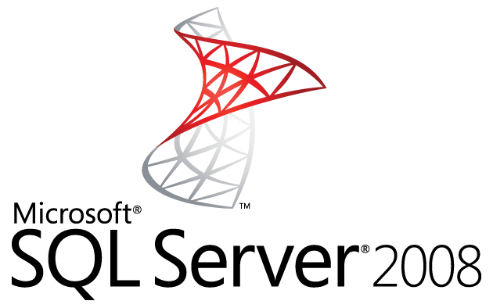
Solution to this problem?
To Automate Data retrieval and reporting
By carrying out ETL process using SSIS, SSRS

Slide 10
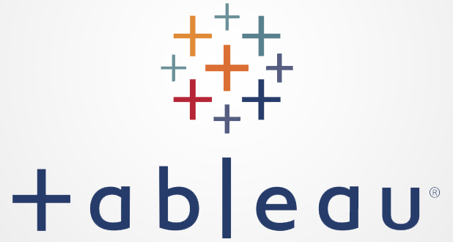
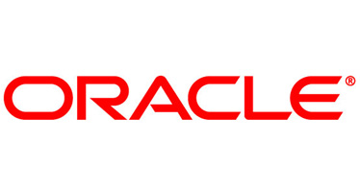
Research – Tools available to use

Slide 11
Research – Tools available to use
SQL Server Integration Services (SSIS)
Replaces DTS – more transformations available
Used entirely for Data integration and workflow applications.
Features a fast/flexible data warehousing tool used for data ETL.
Used to automate maintenance for SQL server databases and updates.
Notes:
Microsoft SQL server – – already using a Microsoft sql server 2008
SSIS is a platform–
SQL Server Integration services
component of MSS.
Used entirely for Data integration and workflow applications.
Features a fast/flexible data warehousing tool used for data ETL.
Used to automate maintance for SQL server databases and updates.
Replaces DTS in 2005 – more transformations available.
Can be developed through BI development studio.
Heterogenius data sources – good for future in case

Slide 12
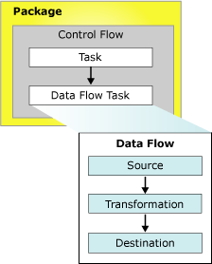
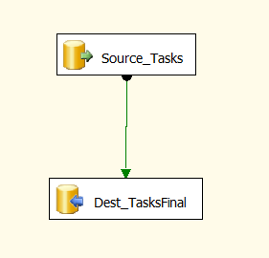
Implementation

Slide 13
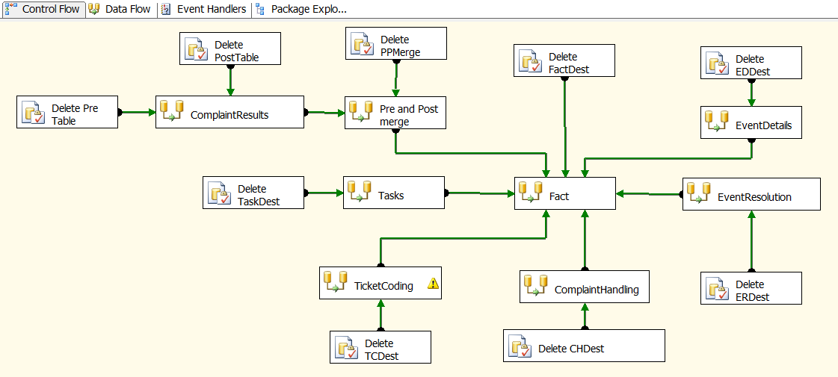
Extract Transformation Load using SSIS

Slide 14
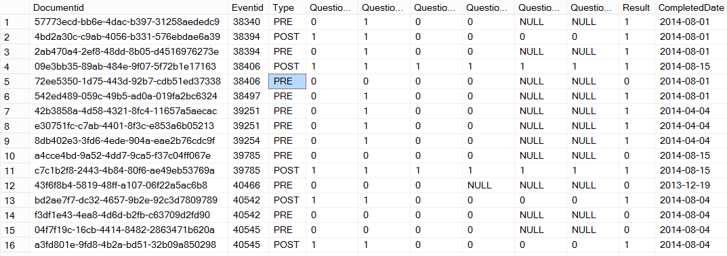
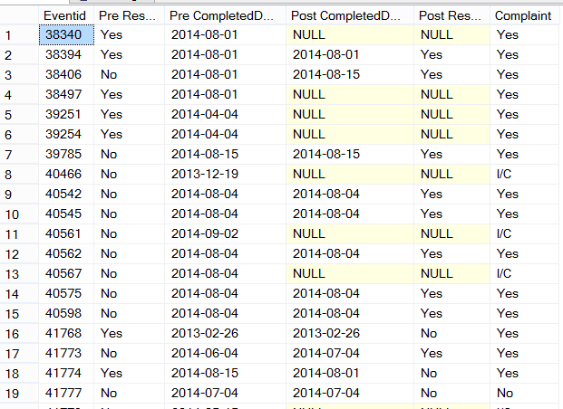

Slide 15
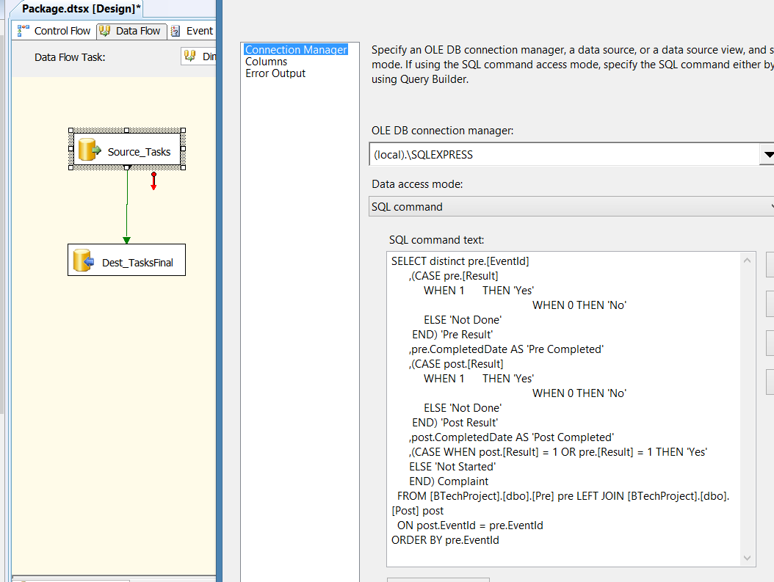
Extract Transformation Load

Slide 16
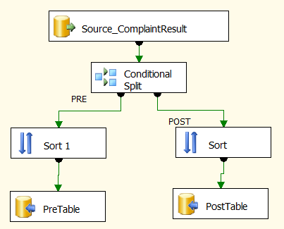
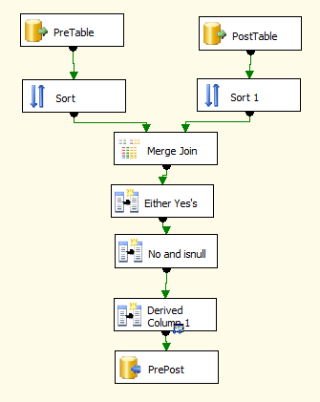
Extract Transformation Load

Slide 17
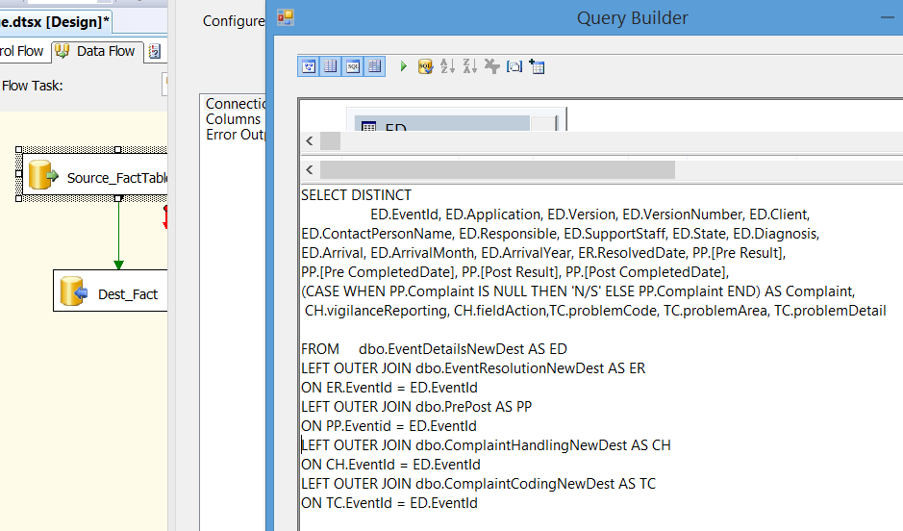

Slide 18
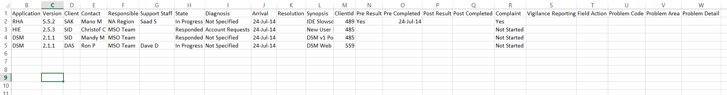

Slide 19
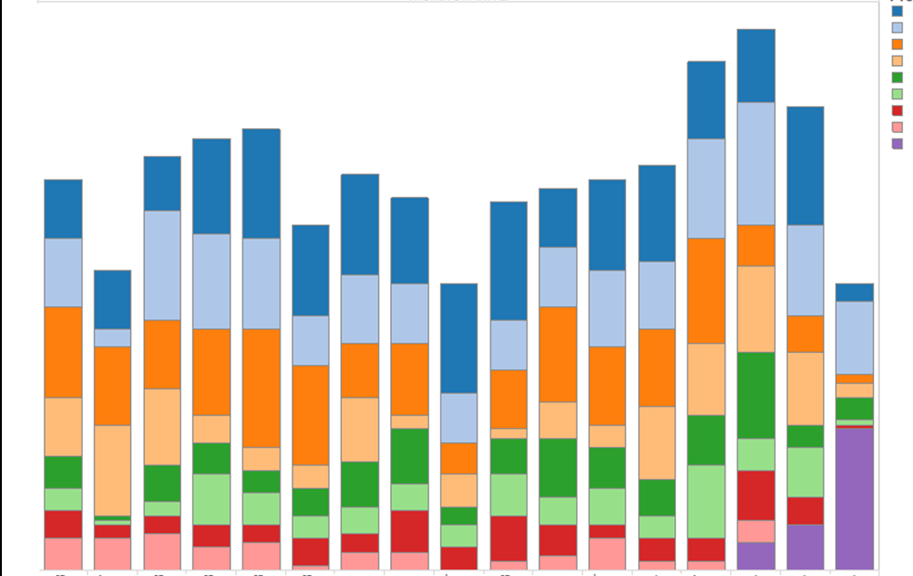
Reports
Problem codes over time

Slide 20
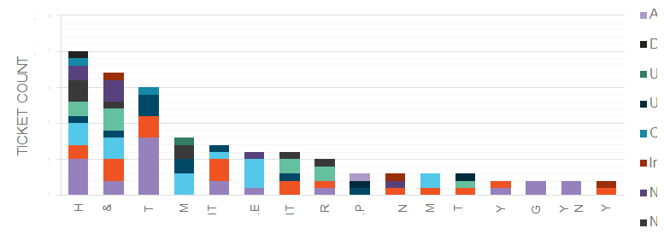
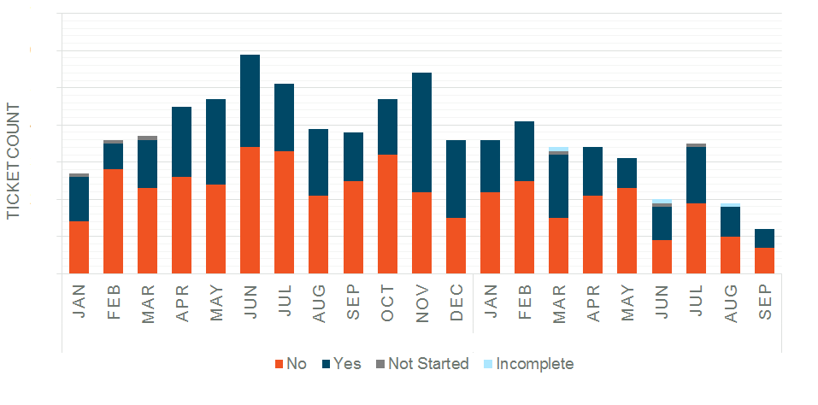
Reports
Problem Code by version
Complaint Status

Slide 21
Motivation
Products are used by 30+ countries therefore it is critical to ensure quality of the product is maintained.
It is critical to pay attention to the complaints which companies receive to ensure the quality of the product is maintained, customers are satisfied and also increase due to good services provided.
Discover trends and patterns using data visualization
Notes:
Products are used by 30+ countries therefore it is critical to ensure quality of the product is maintained.
It is critical to pay attention to the complaints which companies receive to ensure the quality of the product is maintained, customers are satisfied and also increase due to good services provided.
See trends and patterns Using data visualization
Interpreting the transformed data will help show significant changes during a time period for each of the products, components or services which Orion Health provides which can play a major role in decreasing defects and improving these products.
This will also uncover deeper factors and shed light on the service the product has been providing over a time frame e.g. if the problem initially something else and therefore complaints are still arising. This effort will also enable a view of the total reliability of the software in the field, alongside a clear view of the impact of perfective maintenance applied to the product over time.

Slide 22
Conclusion
These are used to:
Generate Metrics for Management
Display trends over time
Provide feedback loop to ensure the right issues are being tackled by development
Provide feedback to regional and global support teams on improvement
Can provide meaning full information faster

Slide 23
What have I gained from this project?
Improved Analytical skills
The ability to work individually
The experience of working in a real firm on a ‘real project’
Improved SQL, SSIS, SSRS skills
Knowledge about BI, ETL techniques

Slide 24
Thank you to..
IT Coordinator
Mano
Academic Supervisor
Christof Lutteroth
Orion Health Supervisors
Amy Foulkes
Chris Lucas
Grace Fernandez

